Slide 1


FINAL PROJECT PRESENTATION Credit Card Fraud Detection System
Submitted By:
Mr. Omesh Satpute
Mr. Vishal Thange
Guide:
Prof. S. D. Bhopale
Academics year 2023-2024
DEPARTMENT OF INFORMATION TECHNOLOGY
SINHGAD INSTITUTE OF TECHNOLOGY , LONAVALA

Slide 2
Contents
1. Introduction
2. Objective / Problem Statement
3. Literature Survey
4. System Architecture / Methodology
5. UML Diagrams
6. Testing
7. Result
8. Conclusion and References

Slide 3
Introduction
Credit Card Fraud can be defined as a case where a person uses someone else’s credit card for personal reasons while the owner and the card issuing authorities are unaware of the fact that the card is being used.
Fraud detection involves monitoring the activities of populations of users in order to estimate, perceive or avoid objectionable behavior, which consist of fraud, intrusion, and defaulting.
Due to increase the rise of E- Commerce, there has been a tremendous use of credit cards for online shopping which led to High amount of frauds related to credit cards. In the era of digitalization, the need to identify credit card frauds is necessary.
In order to identify credit card fraud detection effectively, we need to understand the various technologies, algorithms and types involved in detecting credit card frauds. Algorithm can differentiate transactions which are fraudulent or not.

Slide 4
Objective
The main objective of this project is to perform predictive analysis on credit card transaction dataset using machine learning techniques and detect the fraudulent transactions from the given dataset. The focus is to identify if a transaction comes under normal class or fraudulent class using predictive models.
Credit card frauds are increasing heavily because of fraud financial loss is increasing drastically. Every year due to fraud Billions of amounts lost. To analyze the fraud there is lack of research.

Slide 5
Literature Survey
Sr. no. | Title of Paper | Techniques | Advantegs | Dis-Advantegs
1. | Performance Evaluation of Machine Learning Algorithms for Credit Card Fraud Detection Year : 19 June 2020 Authors: Sangeeta Mittal | Logistic Regression (LR) finds the best fit parameter to estimate the probability of the binary response based on one or more features. | Easy to implement and interpret yet efficient in training. | Overfits on high dimensional data.
2. | Credit Card Fraud Detection Using Machine Learning Algorithms Year : 19 June 2020 Authors: Shivani Tyagi | The K-Nearest Neighbour (KNN) classifiers are instance based supervised learning methods that classifies based on a similarity measure | It can be used for both classification and regression problems. | The performance and generalization of KNN can be affected by the choice of k and distance metric.

Slide 6
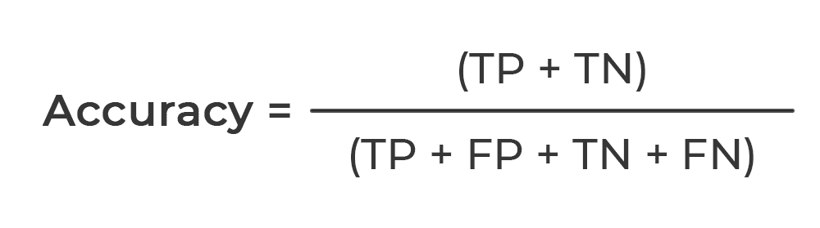

Performance Metrics
The accuracy, based on CM, is the ratio of correct predictions to the sample size as follows:
The precision is the value of TP elements over TP and FP, calculated using CM as follows:

Slide 7
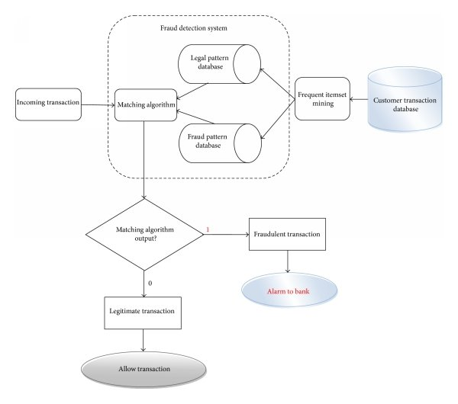
System Architecture / Methodology

Slide 8
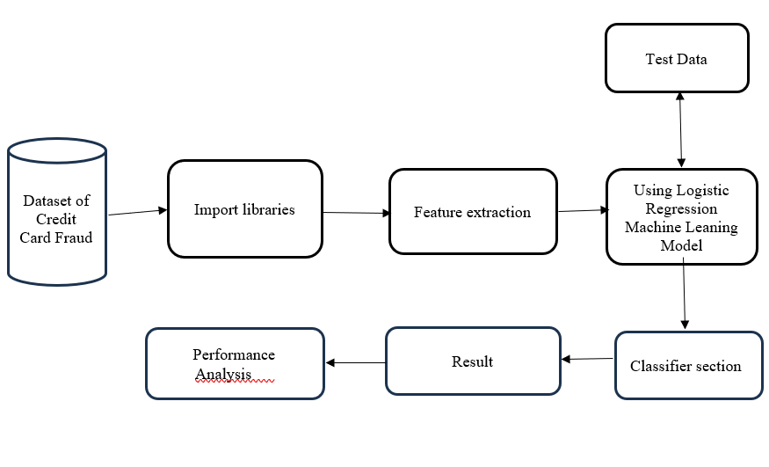
Methodology

Slide 9
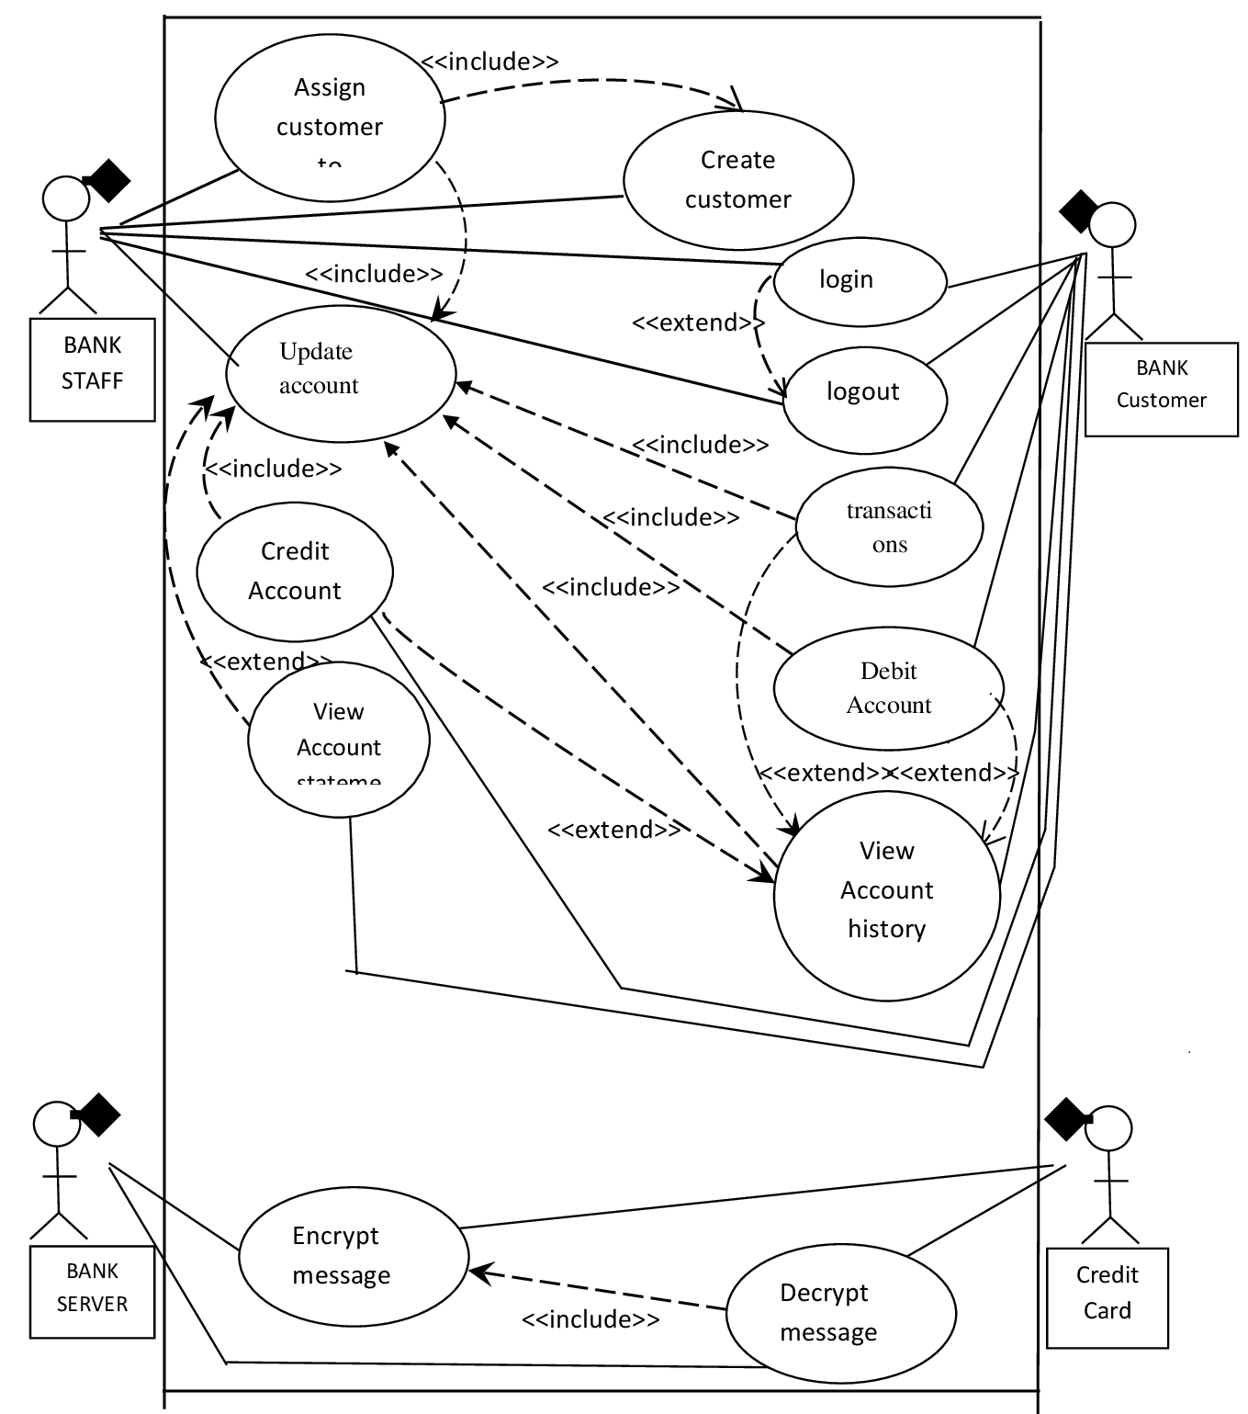
UML Diagrams

Slide 10
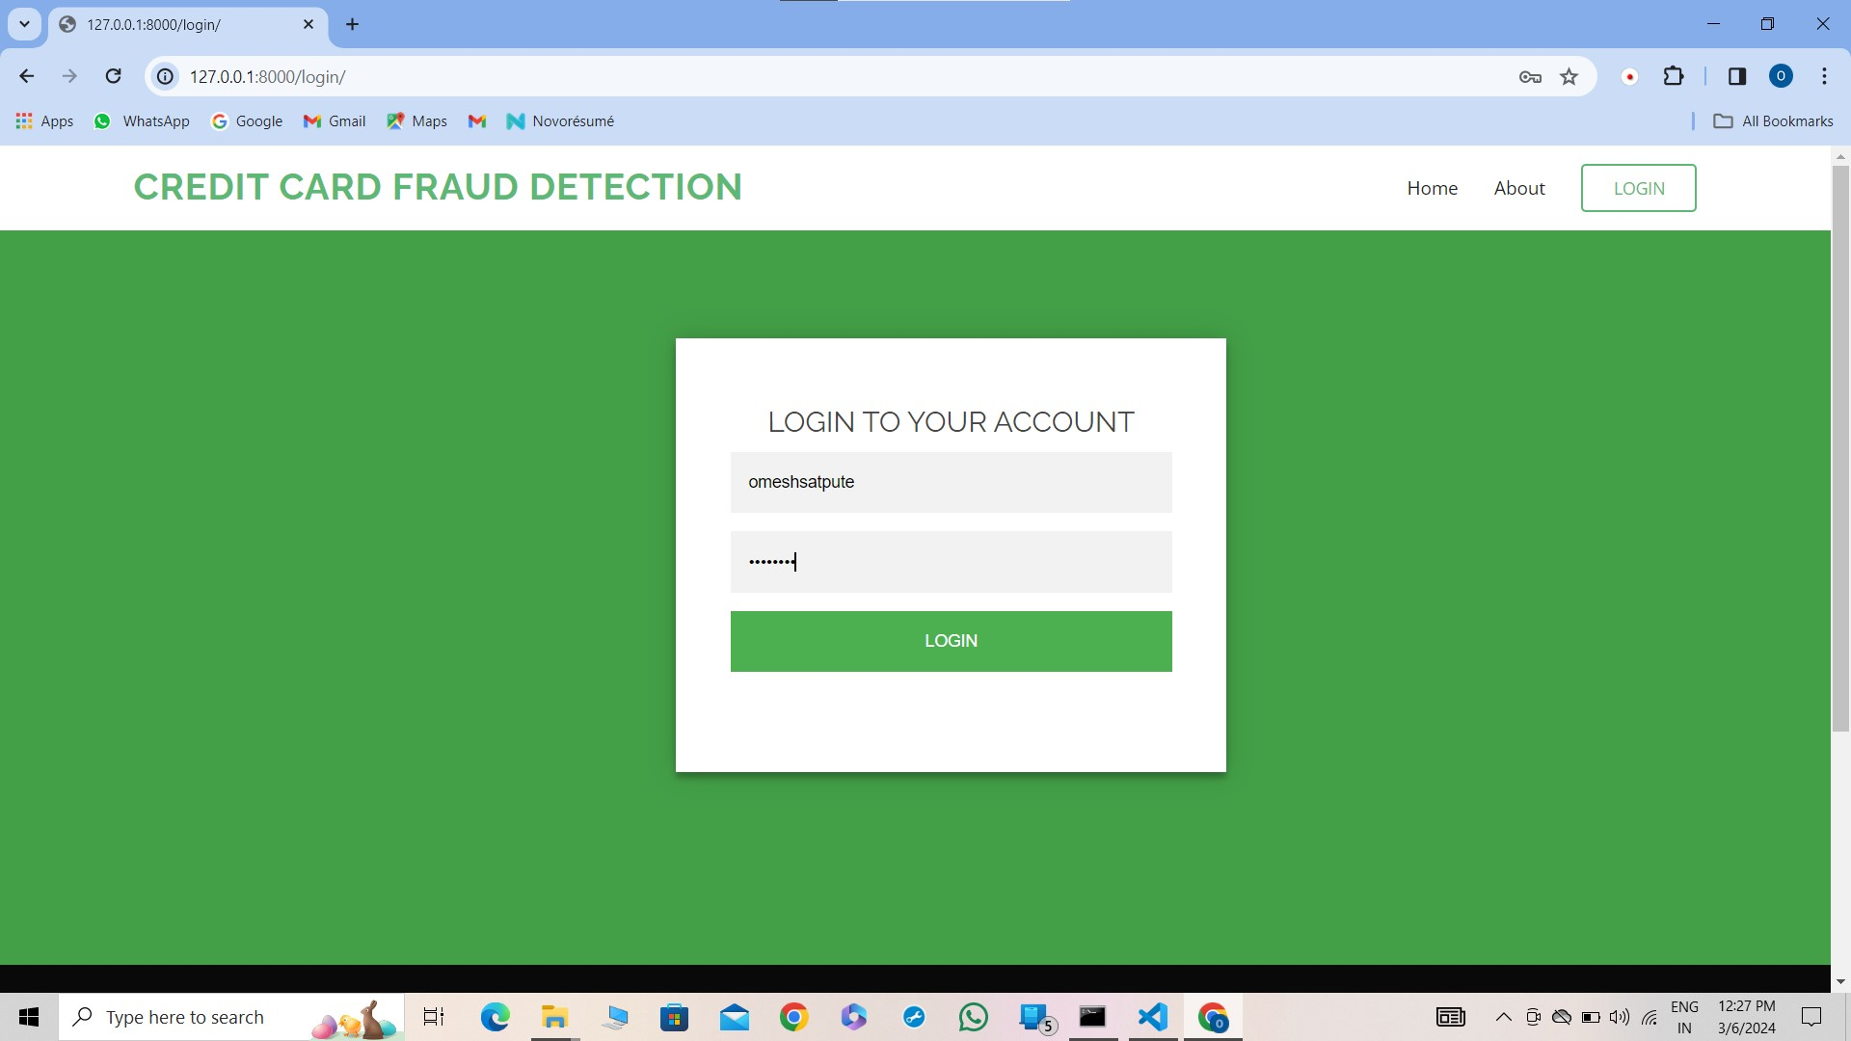
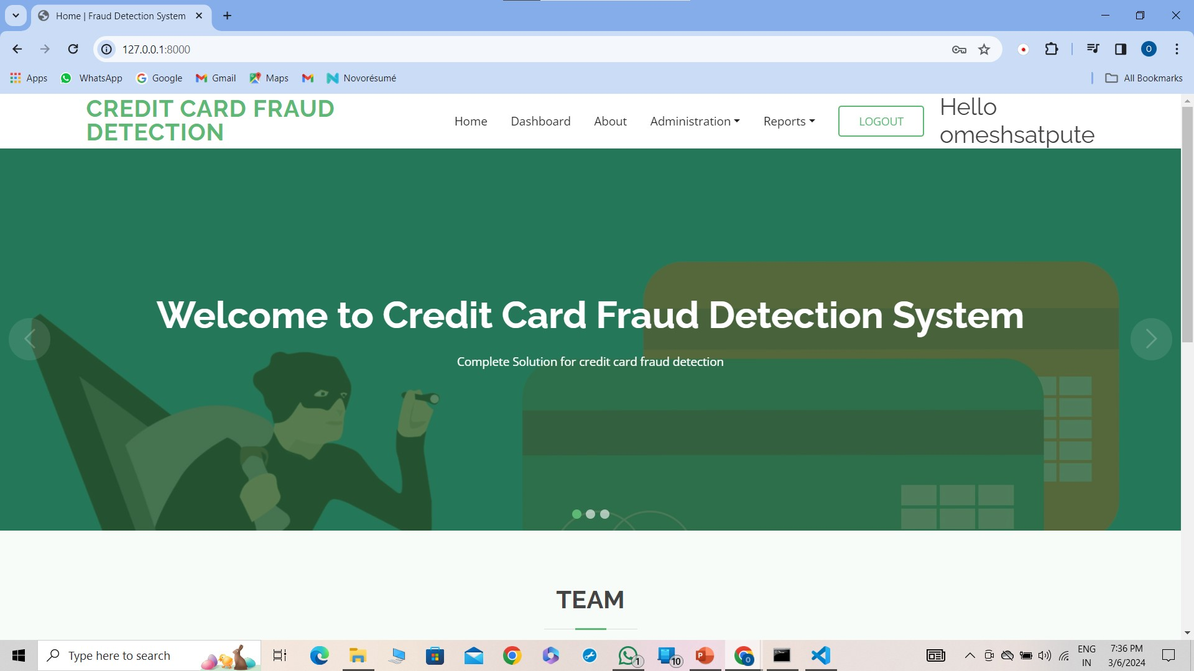
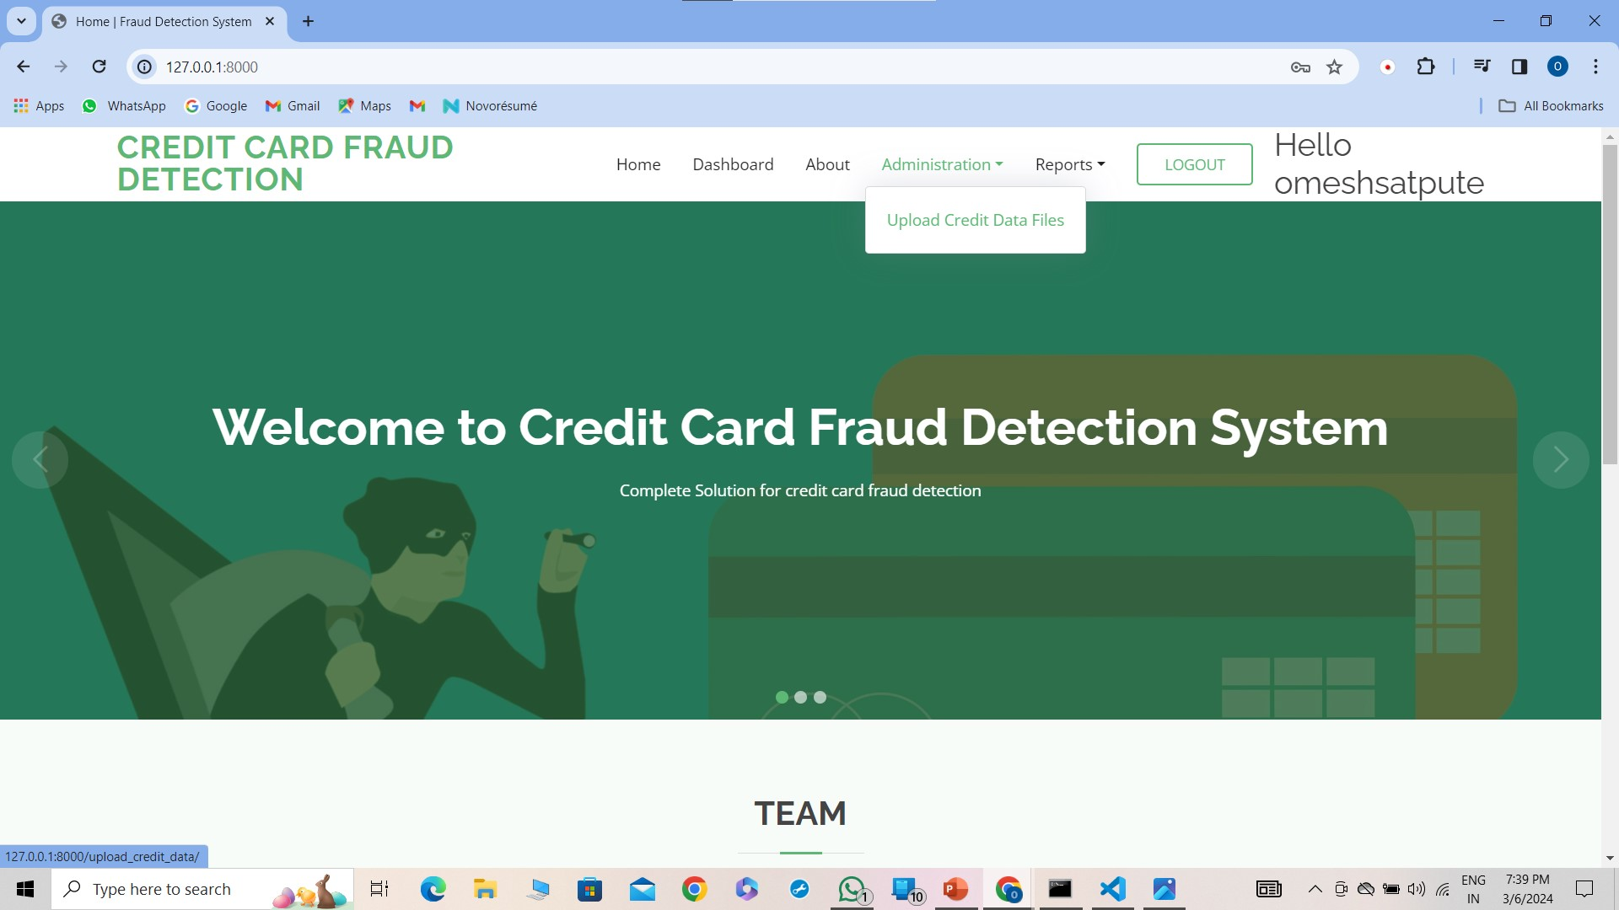
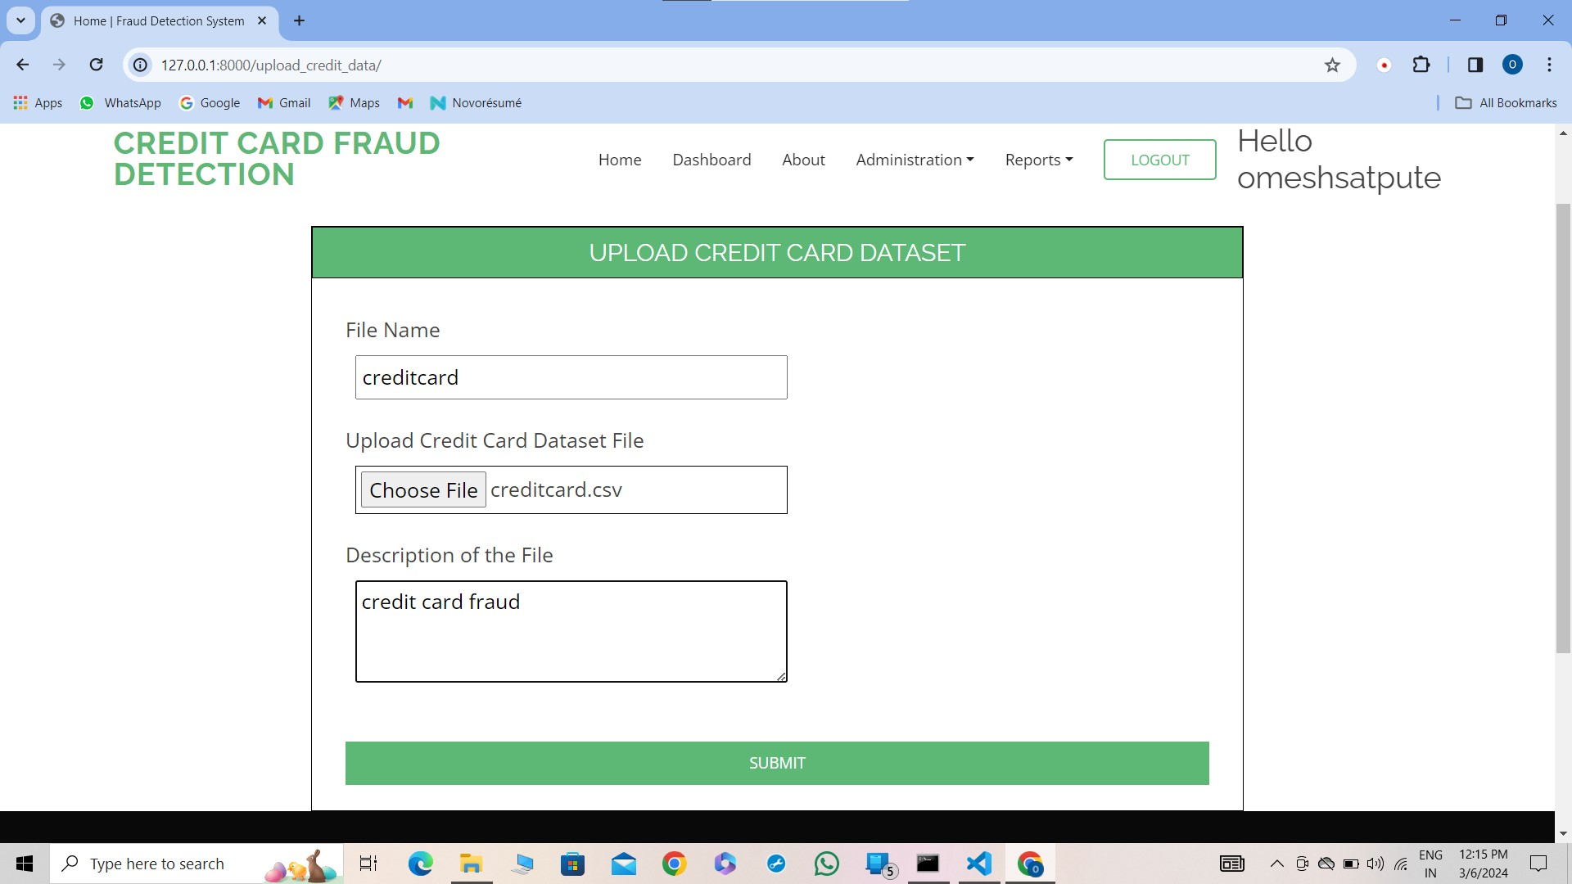
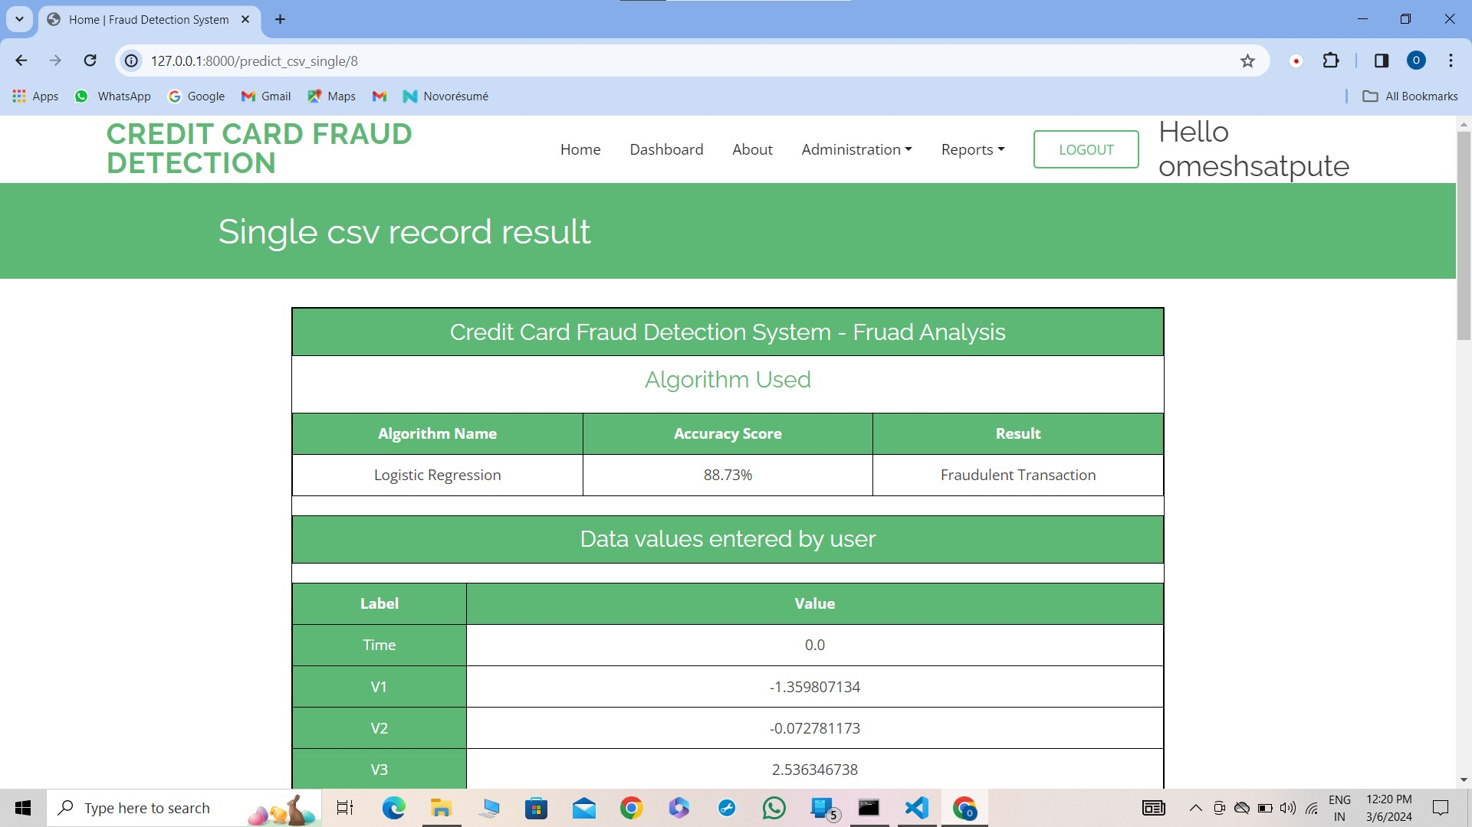
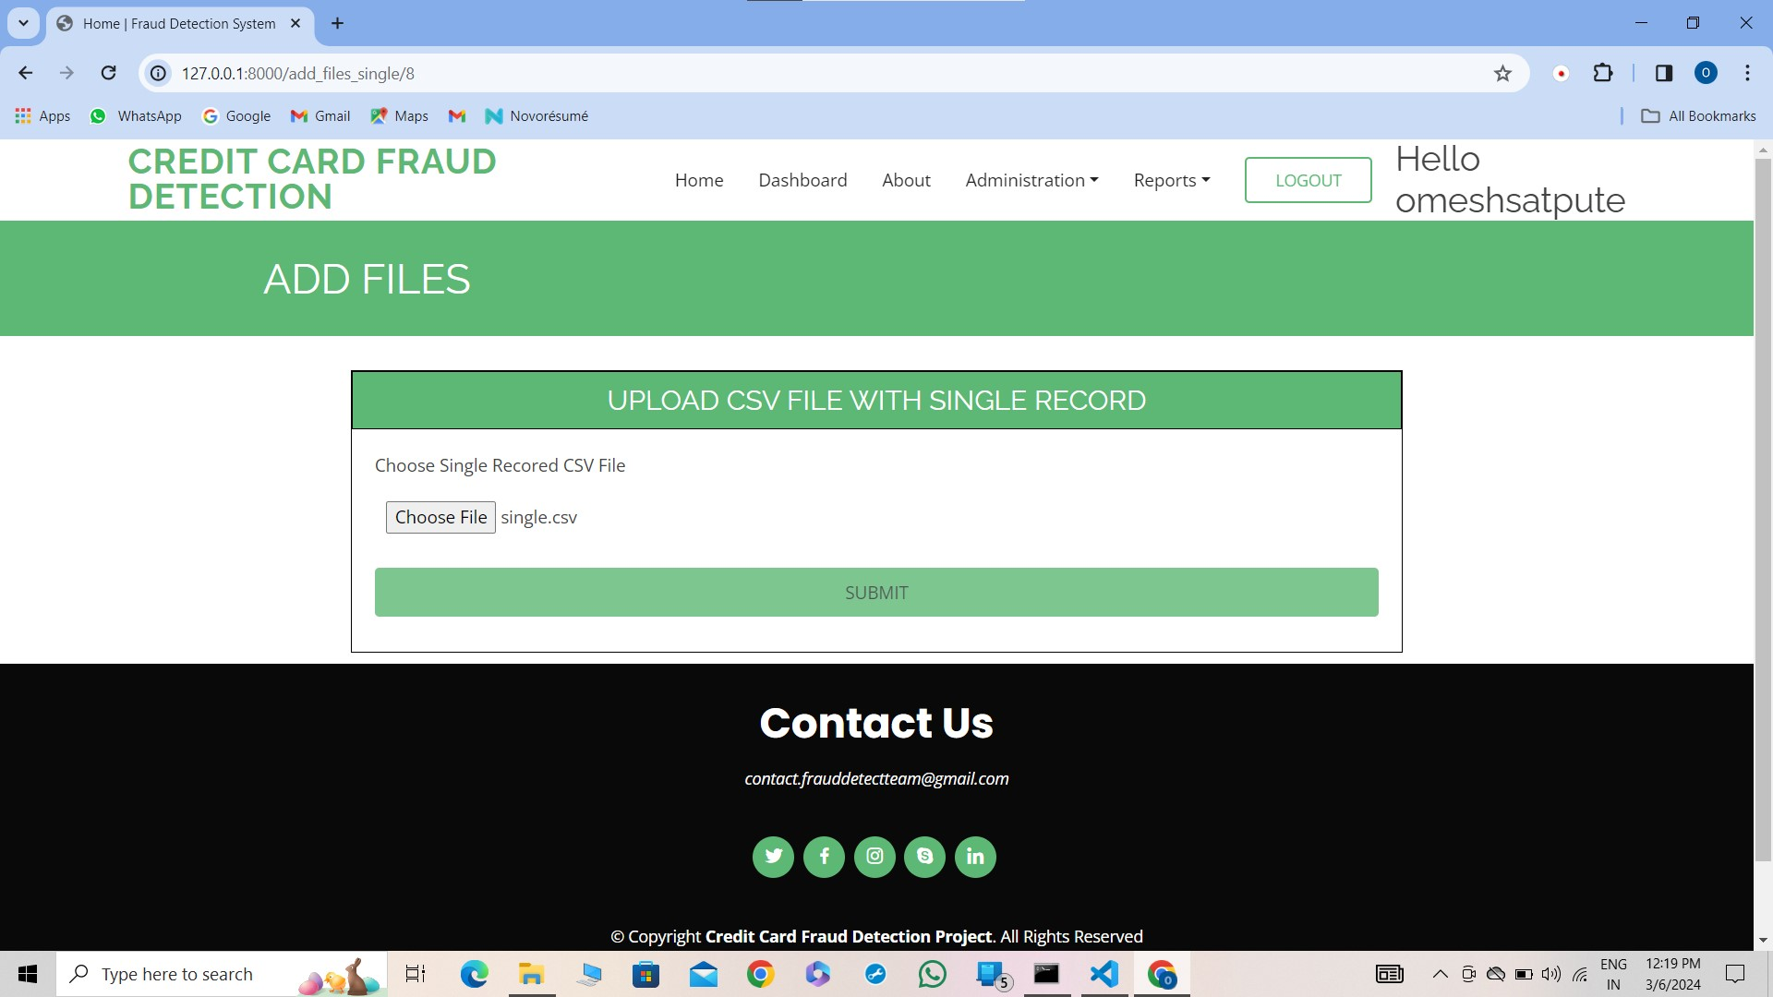
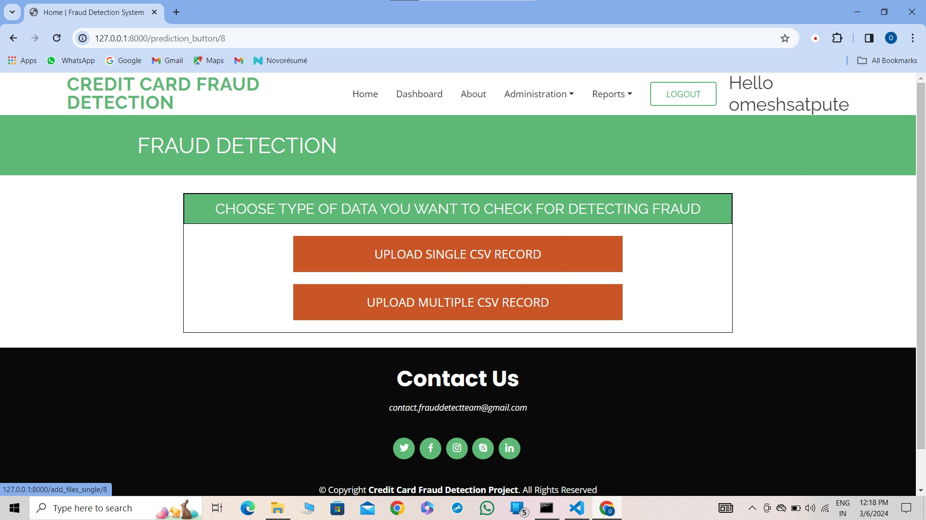
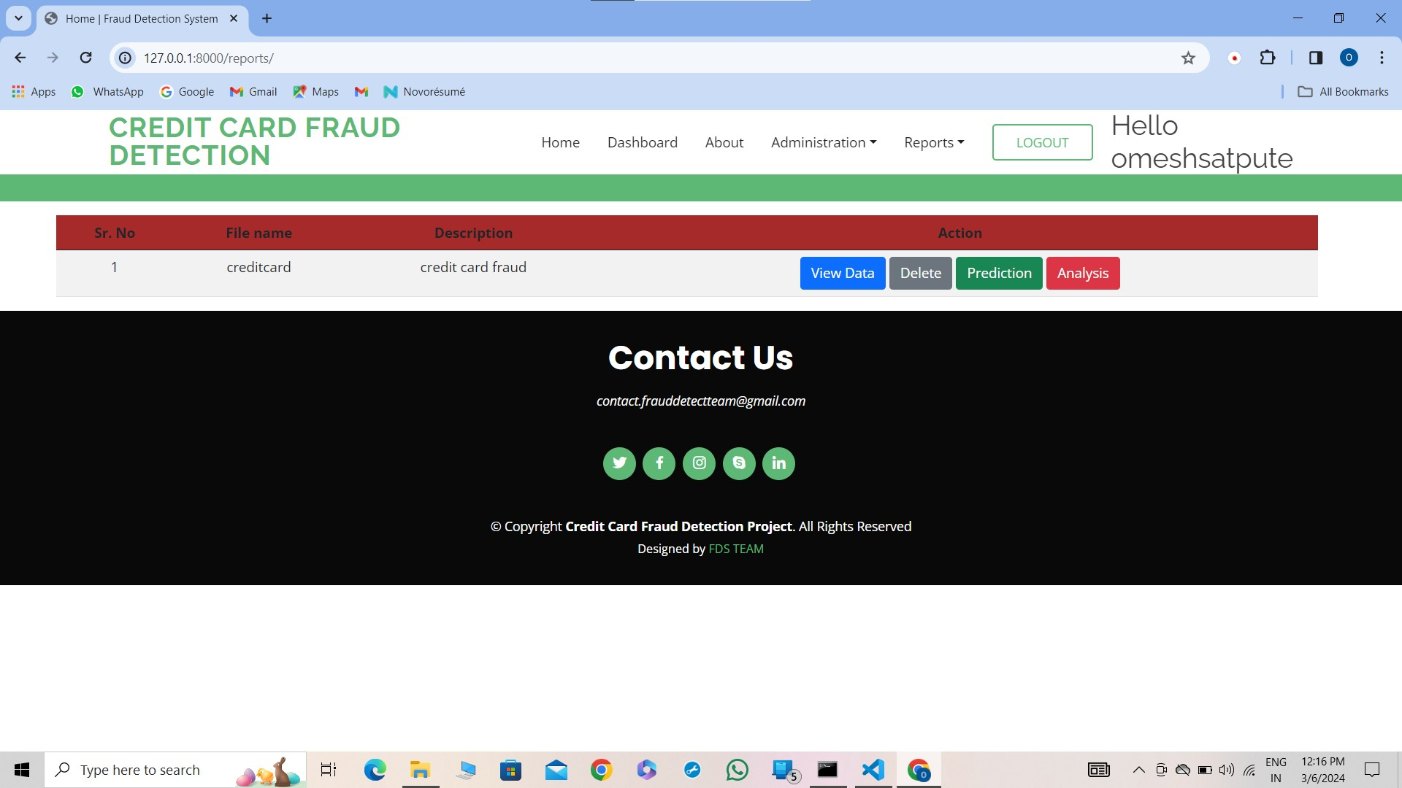
TESTING

Slide 11
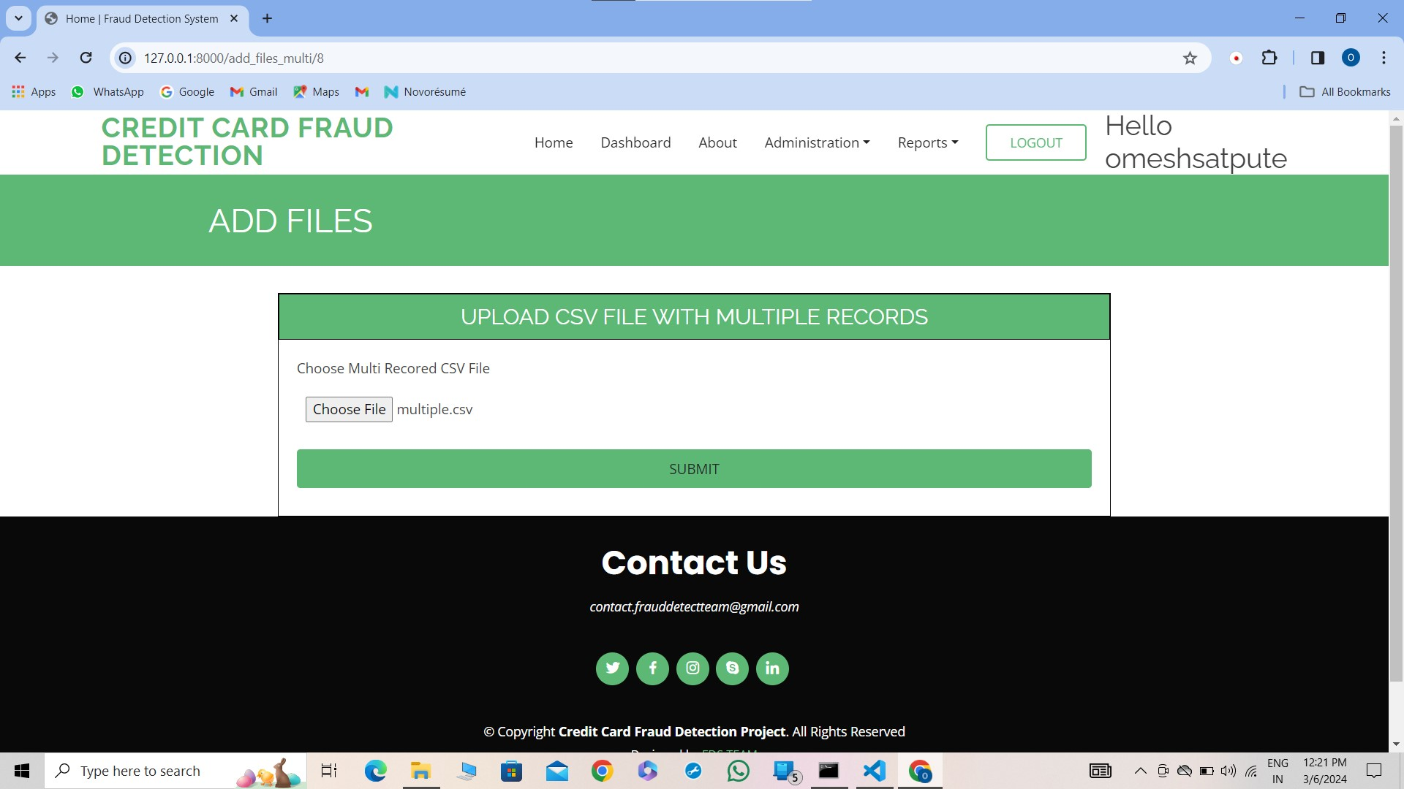
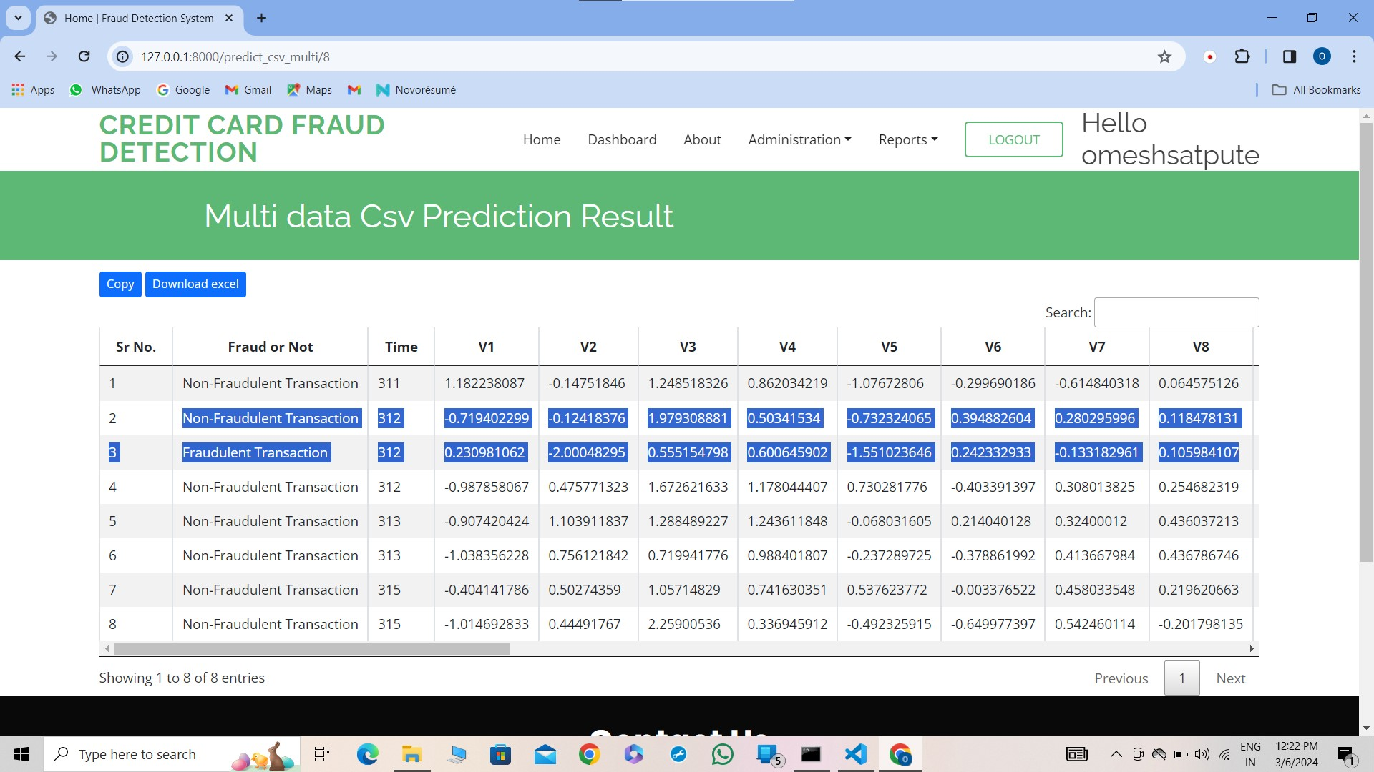
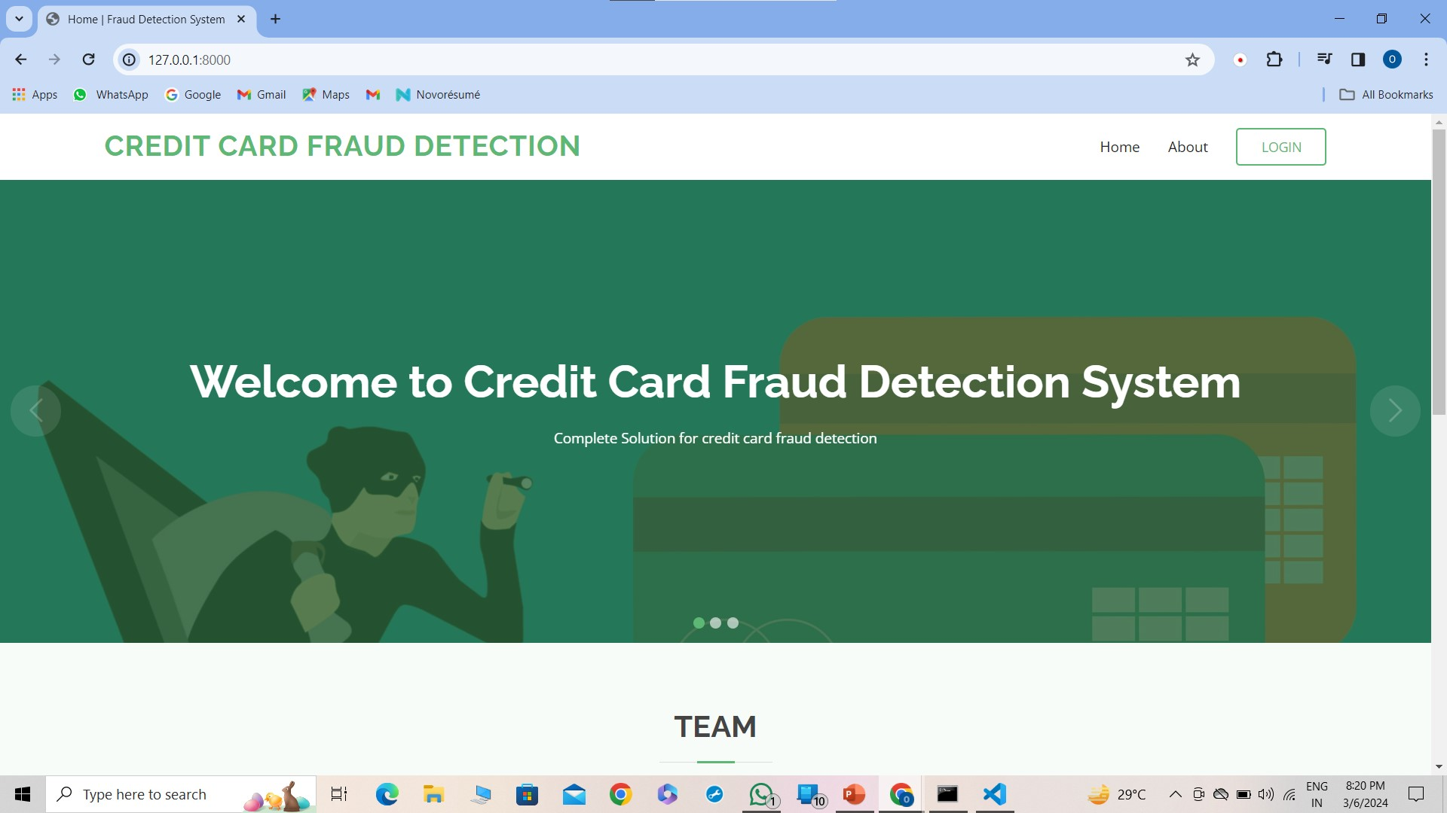
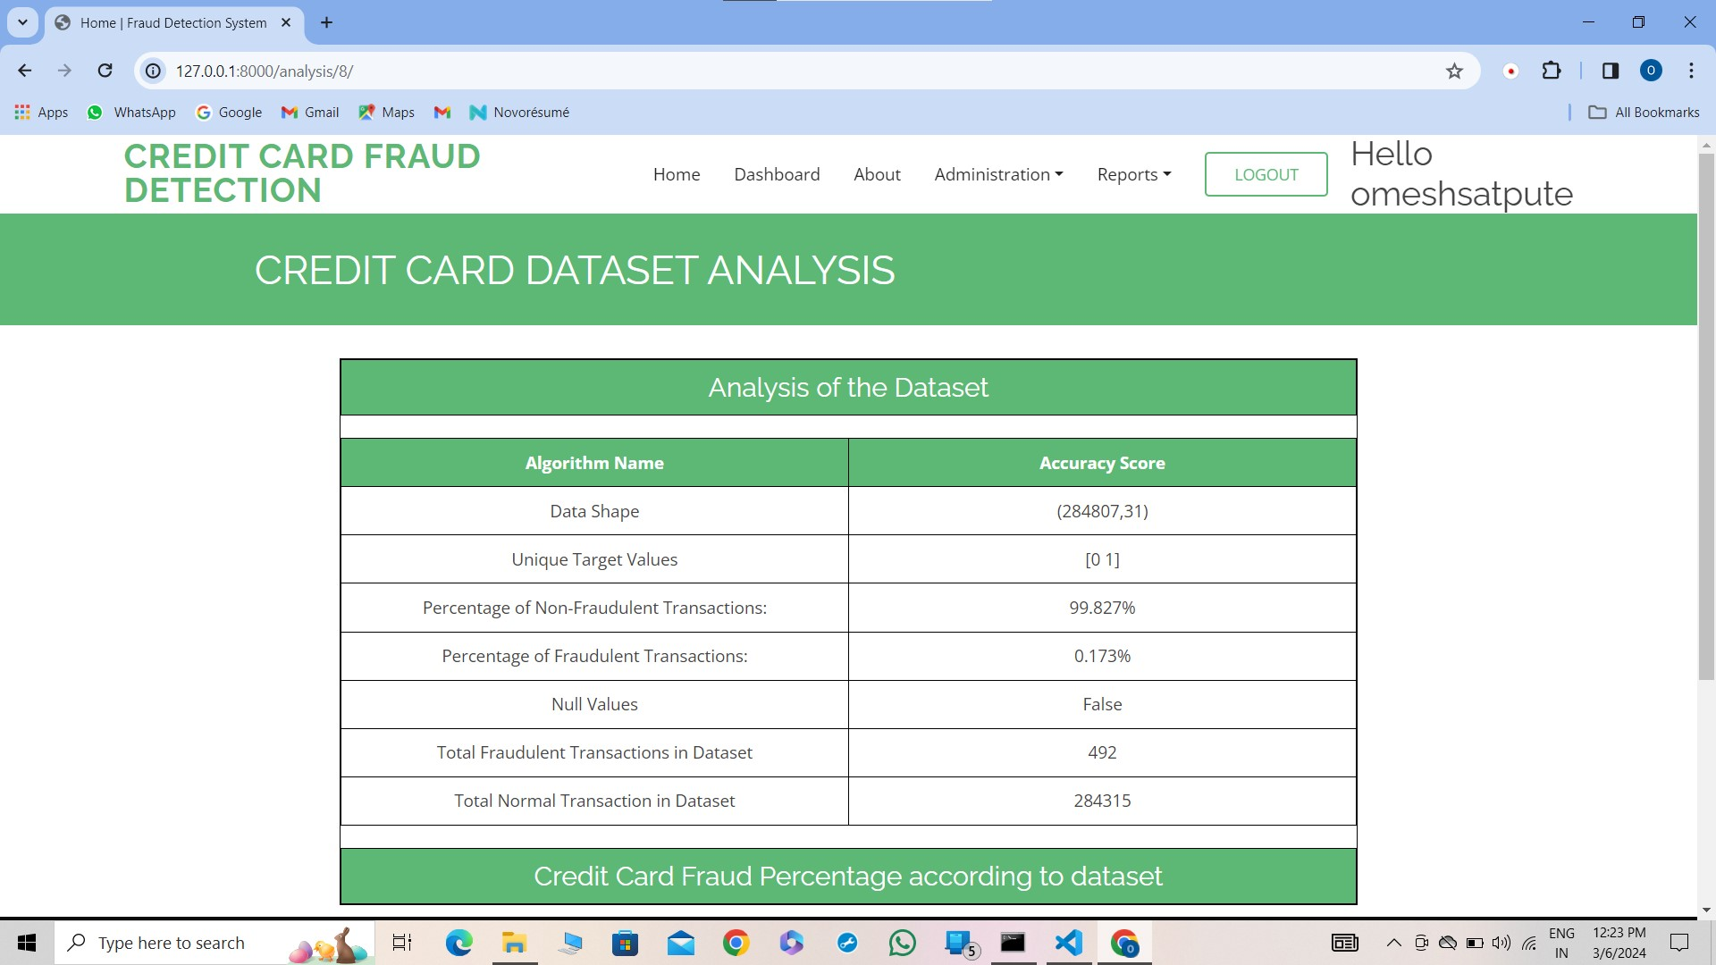
TESTING

Slide 12
Result

Slide 13
Conclusion
Fraud detection is a complex issue that requires a substantial amount of planning before throwing machine learning algorithms at it. Nonetheless, it is also an application of data science and machine learning for the good, which makes sure that the customer’s money is safe and not easily tampered with.
Future work will include a comprehensive tuning of the Logistic Regression algorithm I talked about earlier. Having a data set with non-anonymized features would make this particularly interesting as outputting the feature importance would enable one to see what specific factors are most important for detecting fraudulent transactions.

Slide 14
References
[1] Credit Card Fraud Detection Based on Transaction Behavior -by John Richard D. Kho, Larry A. Vea published by Proc. of the 2017 IEEE Region 10 Conference (TENCON), Malaysia, November 5- 8, 2017
[2] L.J.P. van der Maaten and G.E. Hinton, Visualizing High-Dimensional Data Using t-SNE (2014), Journal of Machine Learning Research
[3] Machine Learning Group — ULB, Credit Card Fraud Detection (2018), Kaggle
[4] Nathalie Japkowicz, Learning from Imbalanced Data Sets: A Comparison of Various Strategies (2000), AAAI Technical Report WS-00–05

Slide 15
Thank you!

